Slide 1
High quality library from scratch
Tools, technologies and acceptance to Boost
Antony Polukhin
Полухин Антон
Boost libraries maintainer (LexicalCast, Any, TypeIndex, Conversion)
+ Boost.CircularBuffer, Boost.Variant

Slide 2

Table of contents
Generic part:
* The Idea
* Portability
* License
* Testing tools
* Documentation
* Checking interest
Boost only:
* Requisitions
* Review
* After Acceptance

Slide 3
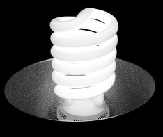
The Idea
* find a problem
* search for existing solutions
* get the Idea of how to solve the problem

Slide 4
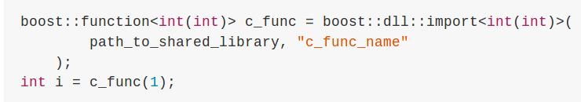
The Idea

Slide 5
Portability
Better portability means more users and more attention to the library.
* Platforms: Linux, Windows, MacOS, Android
* Standards: C++14 C++11 C++98

Slide 6
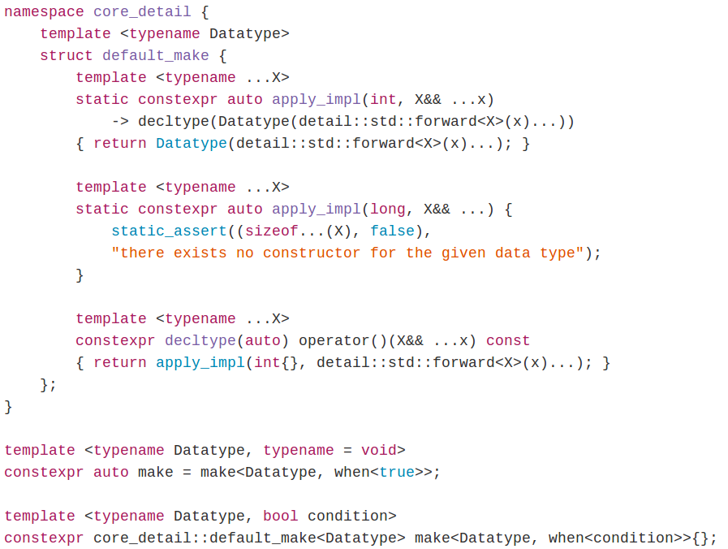
C++14 Library (Hana)

Slide 7

C++14 Library (Hana)

Slide 8
License
Choose according to library purpose:
* educational: LGPL Apache BSD MIT Boost
* making money: [A]GPL+Commercial
* making money in Russia: Commercial
You may have no choice if you forked the project

Slide 9
Testing
Testing is essential for high quality library!
- tests must be run often
- test must cover all the library functionality
- static analysis tools are welcomed

Slide 10
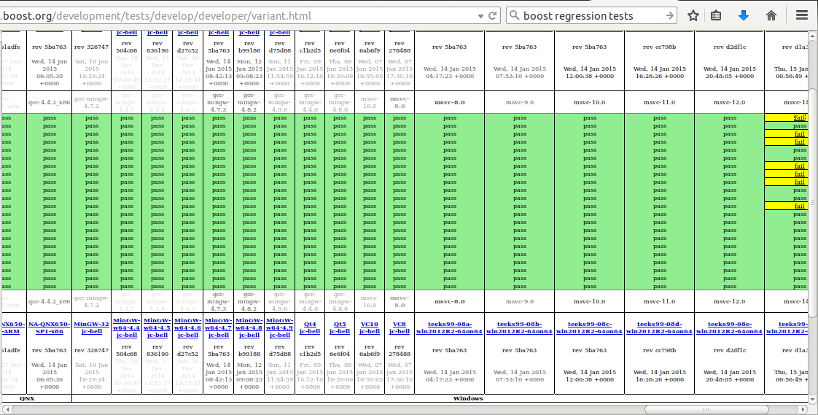
Testing in Boost

Slide 11
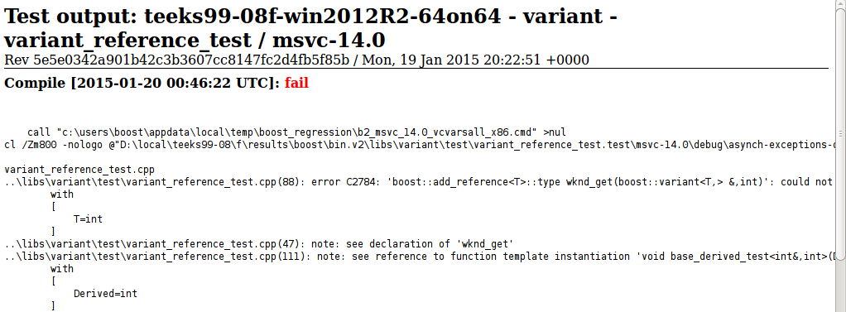
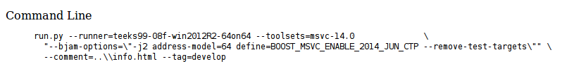
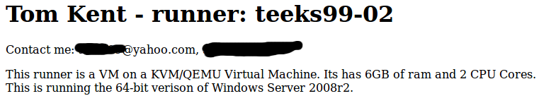
Testing in Boost

Slide 12
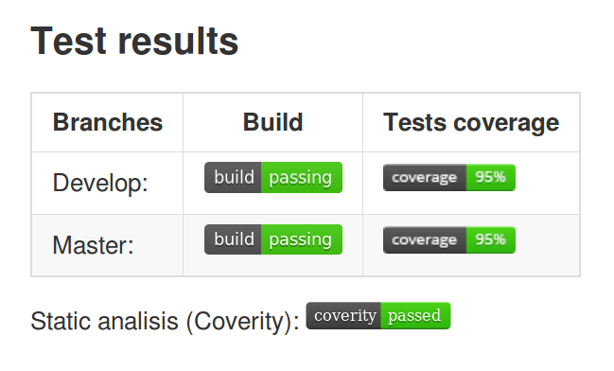
Testing at Github
- TravisCI
- Coveralls
- Coverity

Slide 13
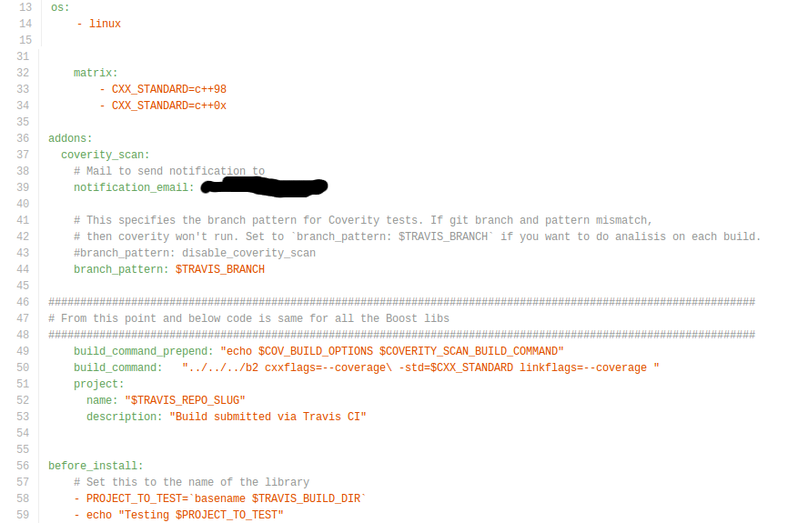
TravisCI

Slide 14
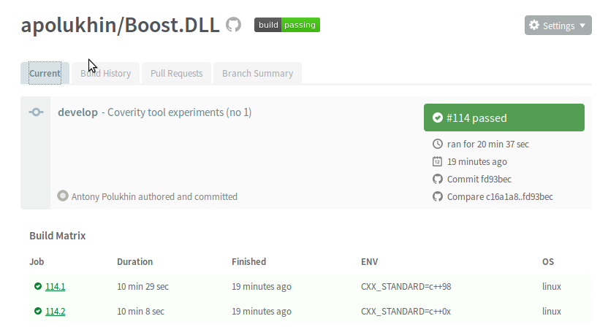
TravisCI

Slide 15
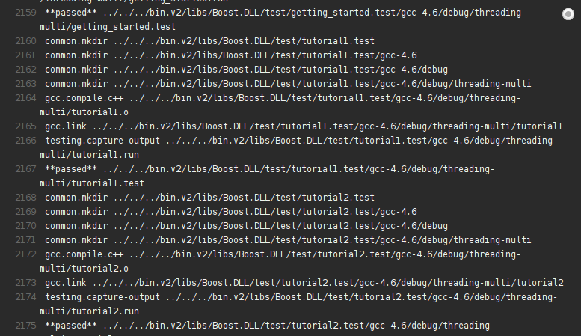
TravisCI

Slide 16
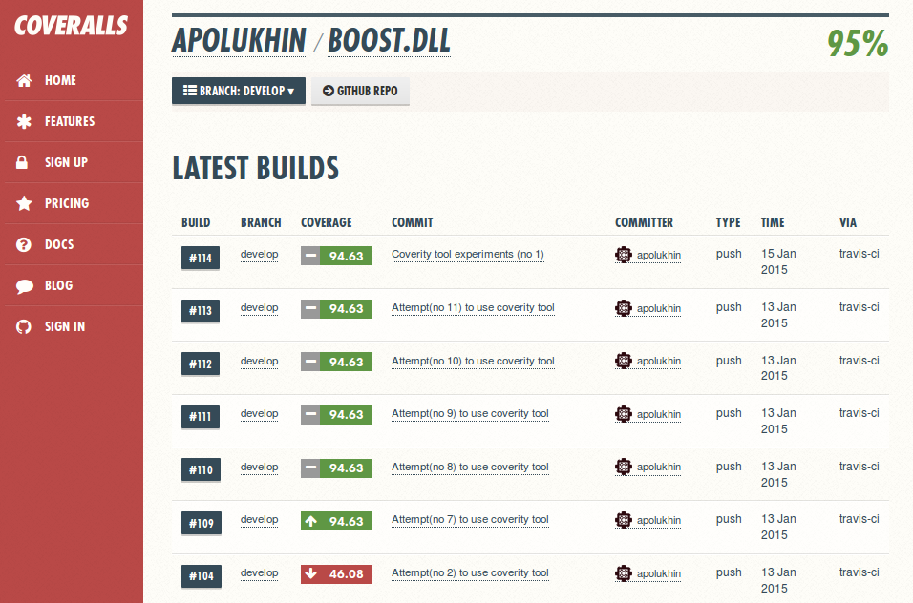
Coveralls

Slide 17
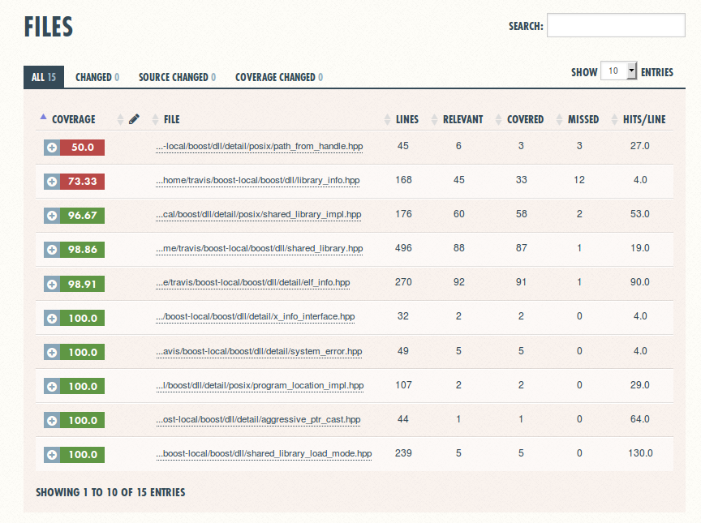
Coveralls

Slide 18
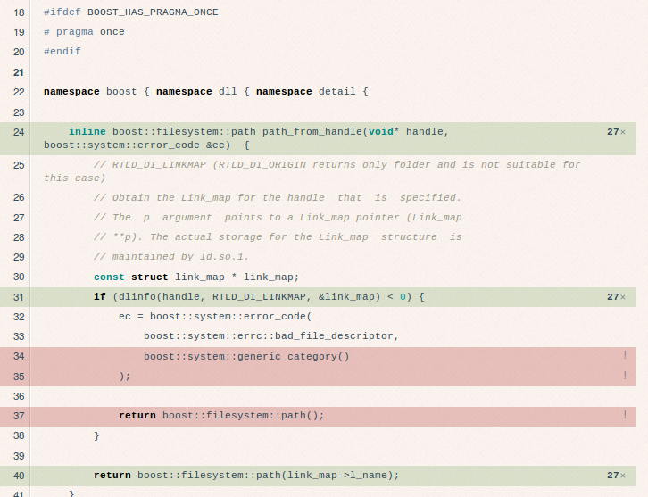
Coveralls

Slide 19
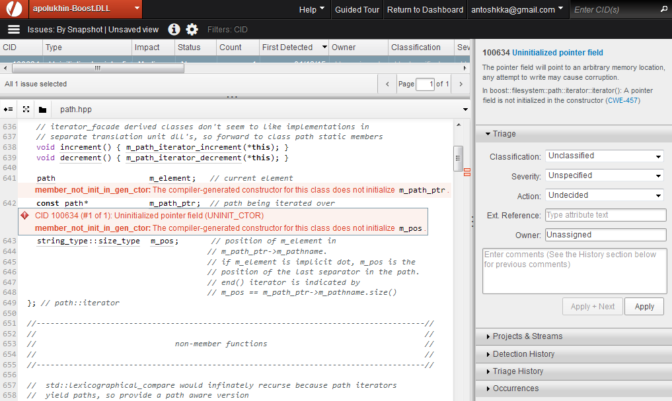
Coverity

Slide 20
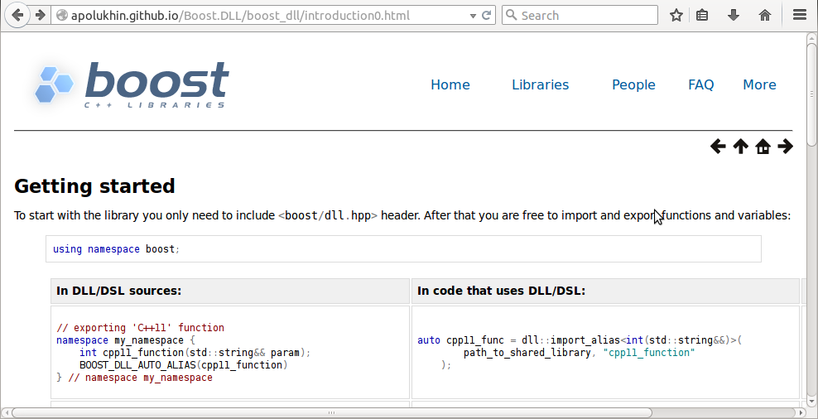
Documentation
* make `gh-pages` branch
* push HTML to it
* PROFIT:

Slide 21
Documentation
* Motivation
* Quick Start
* Tutorial covering basic use cases
* Reference documentation
* How to compile and link
* Rationale for design decisions

Slide 22
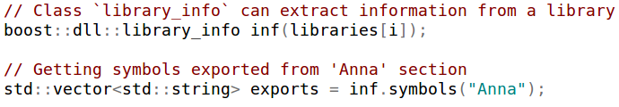
Checking interest
* requests for new features
* comments on API
* requests for documentation clarification
* good ideas and useful links
You are not ought to implement all requests!

Slide 23
Acceptance to Boost
* Requirements:
http://www.boost.org/development/requirements.html
* Boost Library Incubator
http://blincubator.com/
* Review manager

Slide 24
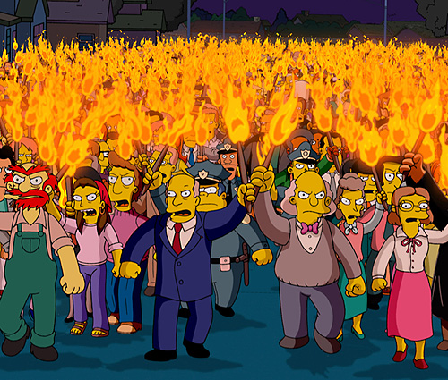
The Review

Slide 25
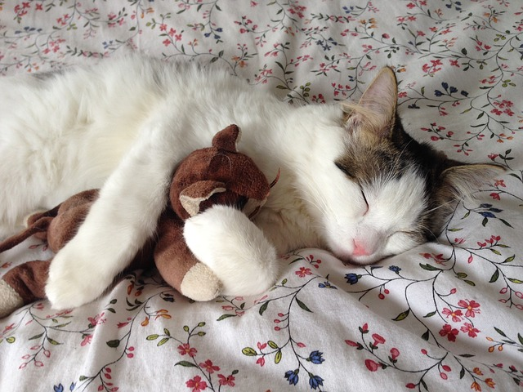
After acceptance

Slide 26

The end
Make your ads || business at http://top-me.org/

